Slide 1
Il follow up
a lungo termine
Damiano Maria Vallero
Natascia Rosolin
SC Endocrinologia e Diabetologia Territoriale ASL CN1

Slide 2
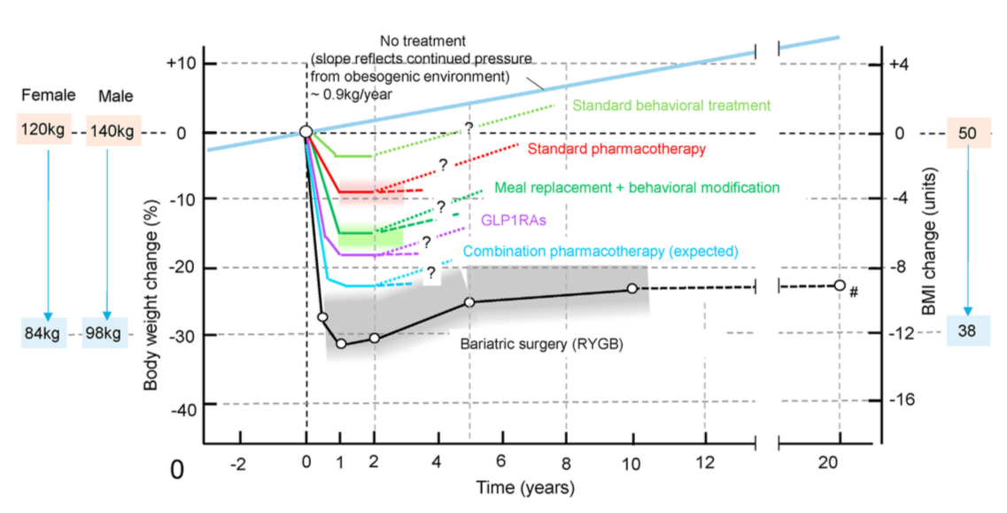
Albaugh VL et al, Regulation of body weight: lessons learned from bariatric surgery, Mol Metab, 68:101517, 2023

Slide 3
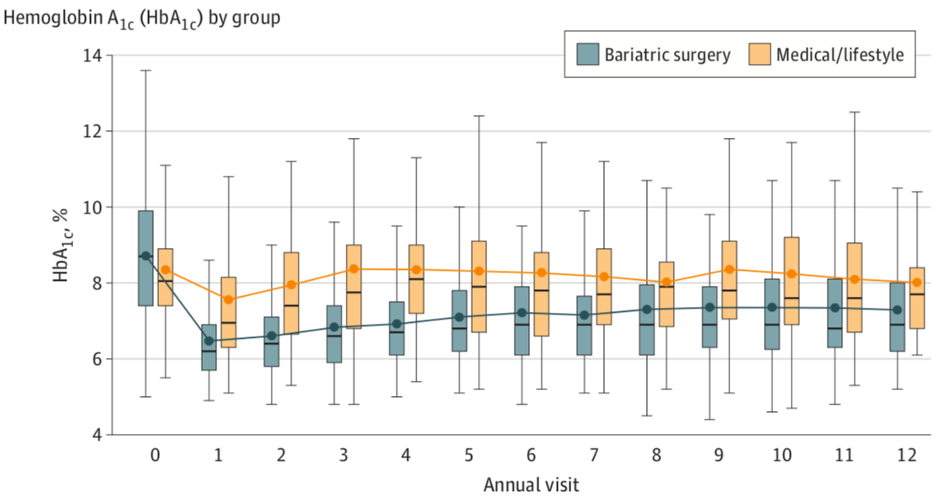
Courcoulas AP et al, Long-Term Outcomes of Medical Management vs Bariatric Surgery in Type 2 Diabetes, JAMA, 331:654-664, 2024

Slide 4
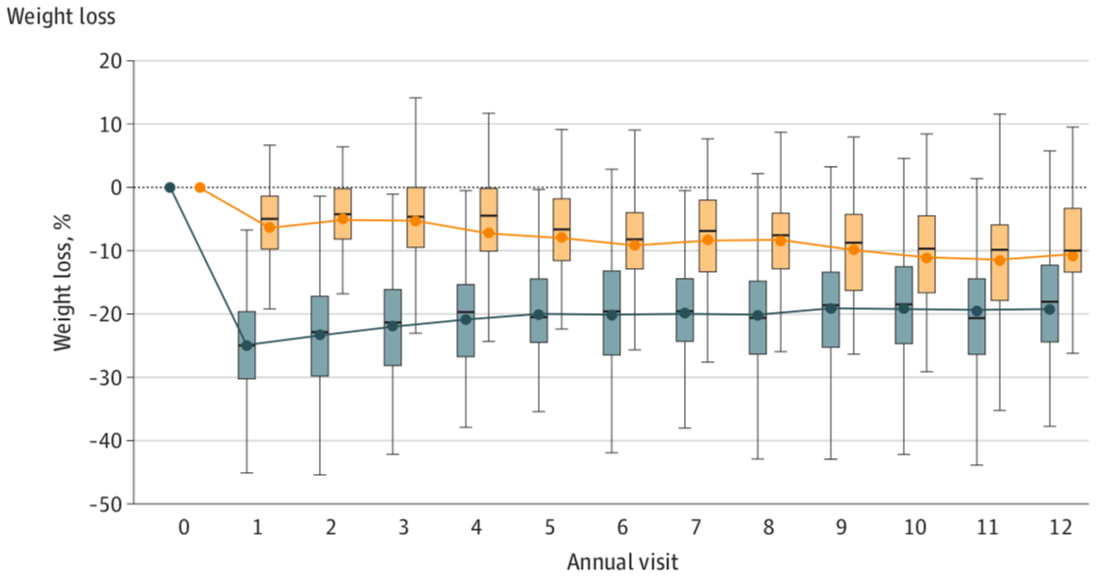
Courcoulas AP et al, Long-Term Outcomes of Medical Management vs Bariatric Surgery in Type 2 Diabetes, JAMA, 331:654-664, 2024

Slide 5
GS Jakobsen et al, Association of Bariatric Surgery vs Medical Obesity Treatment With Long-term Medical Complications and Obesity-Related Comorbidities, 319:291-301, 2018

Slide 6
GS Jakobsen et al, Association of Bariatric Surgery vs Medical Obesity Treatment With Long-term Medical Complications and Obesity-Related Comorbidities, 319:291-301, 2018

Slide 7
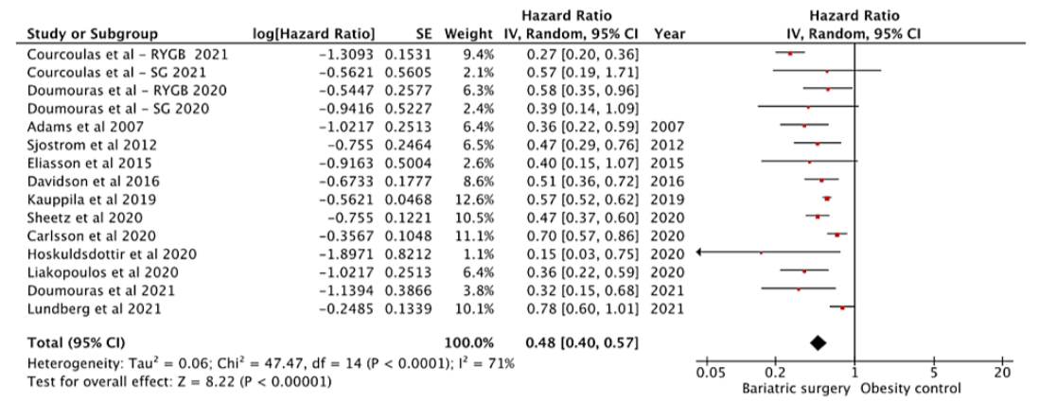
Chandrakumar H et al, The Effects of Bariatric Surgery on Cardiovascular Outcomes and Cardiovascular Mortality: A Systematic Review and Meta-Analysis, Cureus, 15:e34723, 2023

Slide 8
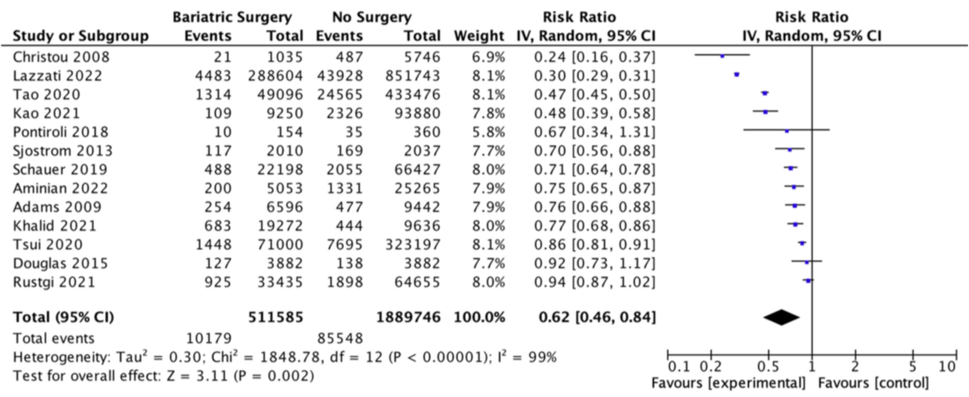
Wilson R et al, Systematic Review and Meta-Analysis of the Impact of Bariatric Surgery on Future Cancer Risk, Int J Mol Sci, 24:6192 2023

Slide 9
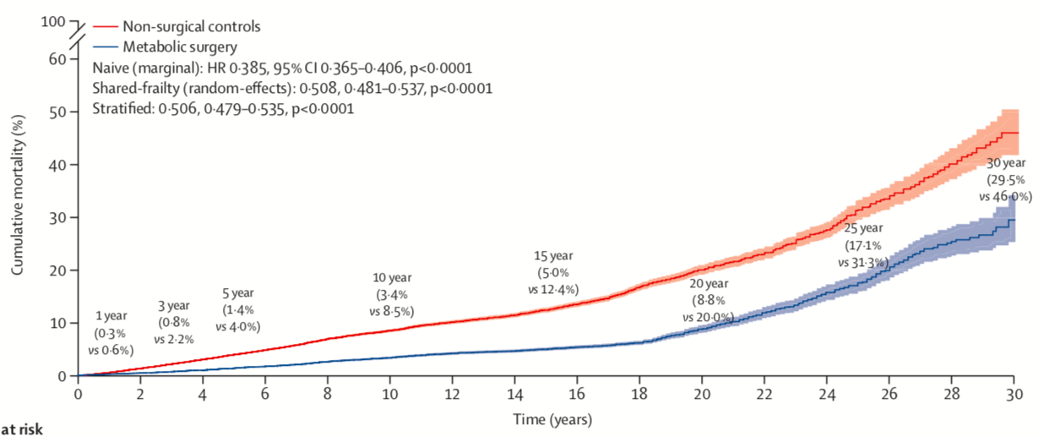
Syn NL et al, Association of metabolic-bariatric surgery with long-term survival in adults with and without diabetes: a one-stage meta-analysis of matched cohort and prospective controlled studies with 174 772 participants, Lancet, 397:1830-1841, 2021

Slide 10
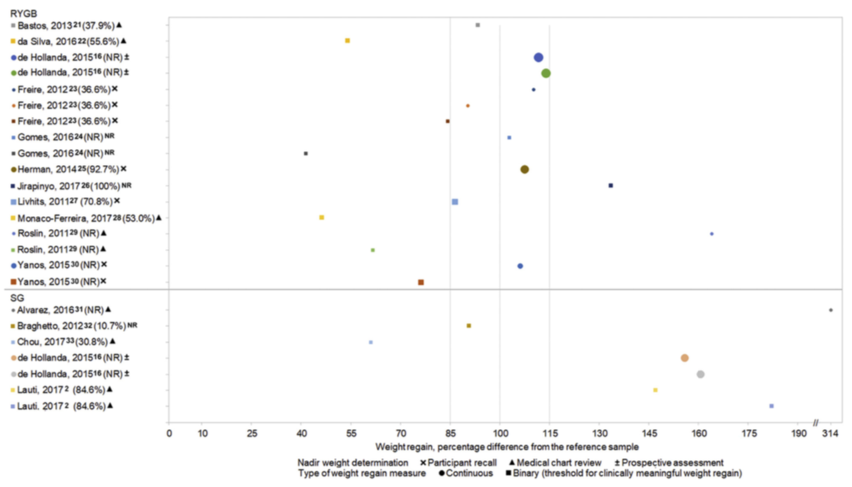
King WC et al, Weight regain after bariatric surgery: a systematic literature review and comparison across studies using a large reference sample, Surg Obes Relat Dis, 16:1133-1144, 2020

Slide 11
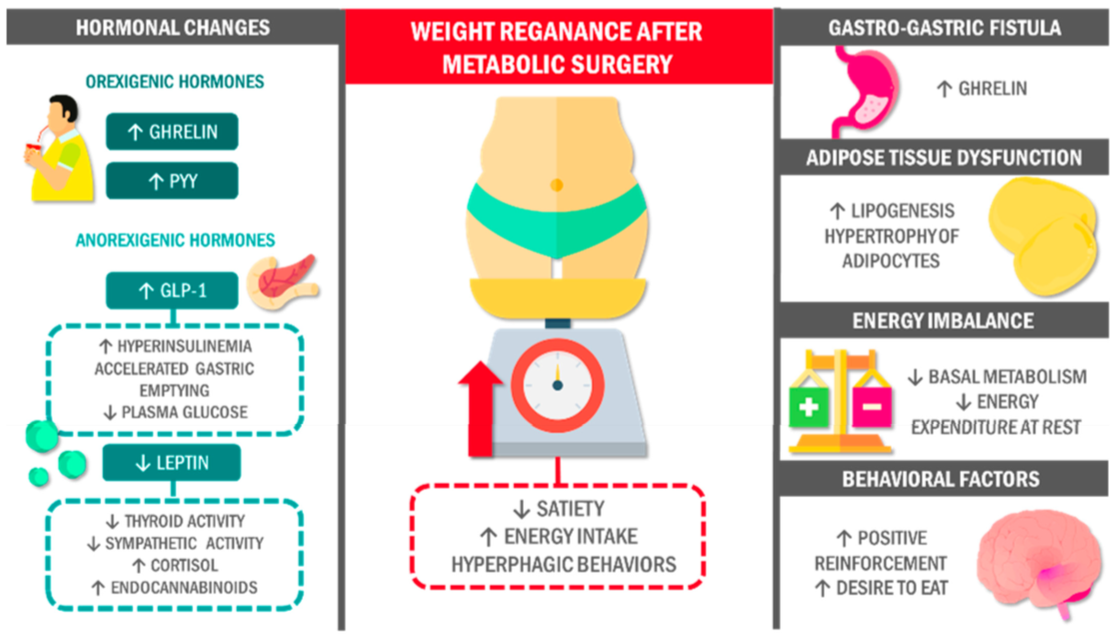
Salazar J et al, Weight Regain after Metabolic Surgery: Beyond the Surgical Failure, J Clin Med, 13:1143, 2024

Slide 12
Vinciguerra F et al, Efficacy of High-dose Liraglutide 3.0 mg in Patients with Poor Response to Bariatric Surgery: Real-world Experience and Updated Meta-analysis, Obes Surg, 34:303-309, 2024

Slide 13
Pharmacotherapy
The %TWL was significantly higher in the “weight regain” group (1.9 ± 4.3) compared with the “insufficient weight loss” group (0.7 ± 4.2) [p = 0.0067]
Revisional Surgery
The %TWL was significantly higher in “insufficient weight loss” group (23.8 ± 11.0) compared to “weight regain” group (17.2 ± 7.9) [p = 0.022]
Dharmaratnam VM et al, Revisional Surgery or Pharmacotherapy for Insufficient Weight Loss and Weight Regain After Primary Bariatric Procedure: a Descriptive Study, Obes Surg, 32:3298-3304, 2022

Slide 14
Protein malnutrition is a rare but potentially serious metabolic complication of proximal RYGB (Roux-en-Y gastric bypass), reported in a pooled median of 1.7% (range 0%-8.9%) of patients in the present review.
Although protein malnutrition is much less common after RYGB than malabsorptive procedures such as OAGB (one anastomosis gastric bypass), BPD/DS (biliopancreatic diversion with duodenal switch), and D-RYGB (distal Roux-en-Y gastric bypass), it still concerns a substantial number of patients given the total number of RYGB performed worldwide.
Mantziari S et al, Protein malnutrition after Roux-en-Y gastric bypass: a challenging case and scoping review of the literature, Surg Obes Relat Dis, 19:746-754, 2023

Slide 15
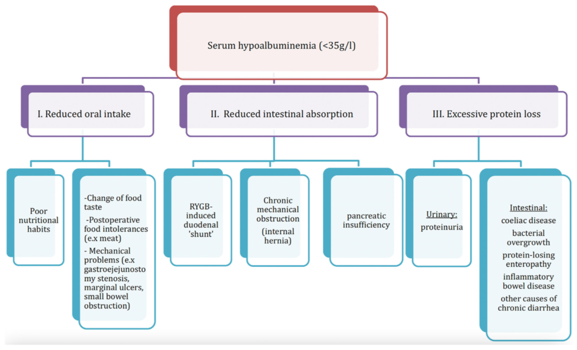
Mantziari S et al, Protein malnutrition after Roux-en-Y gastric bypass: a challenging case and scoping review of the literature, Surg Obes Relat Dis, 19:746-754, 2023

Slide 16
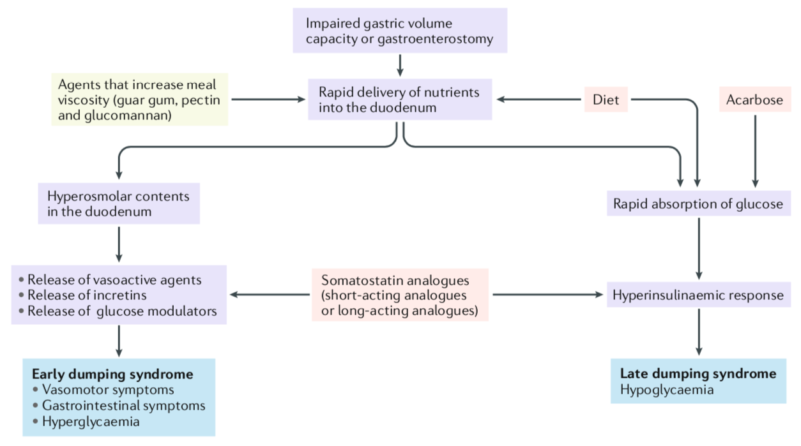
Scarpellini E et al, International consensus on the diagnosis and management of dumping syndrome, Nat Rev Endocrinol, 16:448-466, 2020

Slide 17
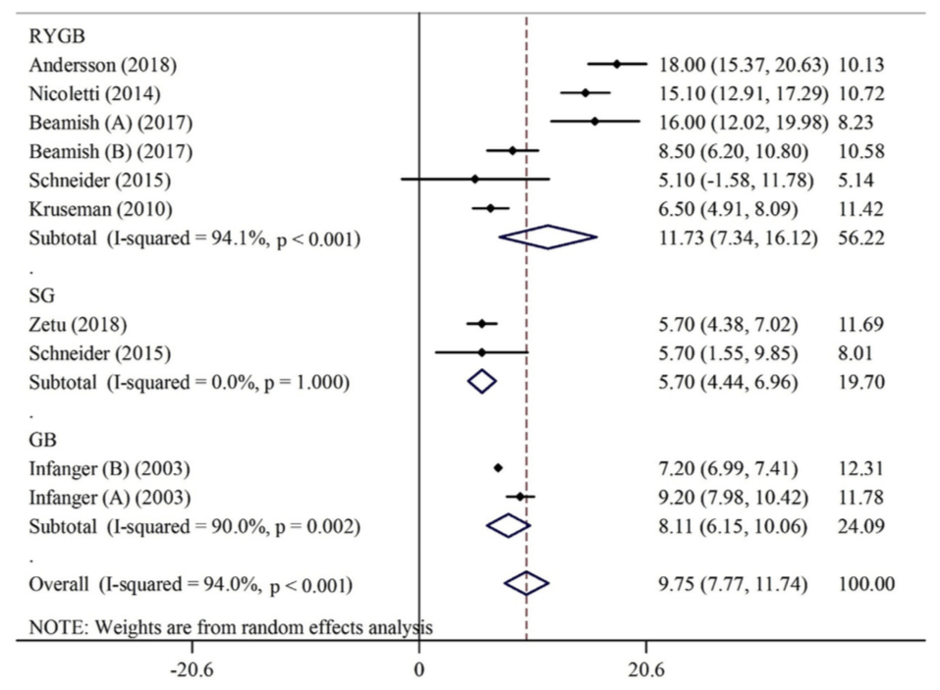
Haghighat N et al, Long-term effect of bariatric surgery on body composition in patients with morbid obesity: A systematic review and meta-analysis, Clin Nutr, 40:1755-1766, 2021

Slide 18
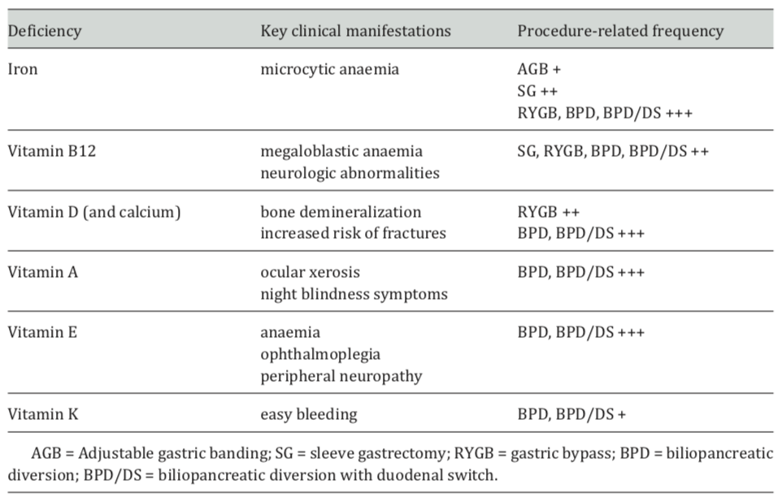
Busetto L et al, Practical Recommendations of the Obesity Management Task Force of the European Association for the Study of Obesity for the Post-Bariatric Surgery Medical Management, Obes Facts, 10:597-632, 2017

Slide 19
Busetto L et al, Practical Recommendations of the Obesity Management Task Force of the European Association for the Study of Obesity for the Post-Bariatric Surgery Medical Management, Obes Facts, 10:597-632, 2017
Kob M, The need for standardized evidence-based recommendations for vitamin-mineral supplementation after sleeve gastrectomy. A review of current guidelines, 22nd World Congress of the International Federation for the Surgery of Obesity and Metabolic Disorders, 2017

Slide 20
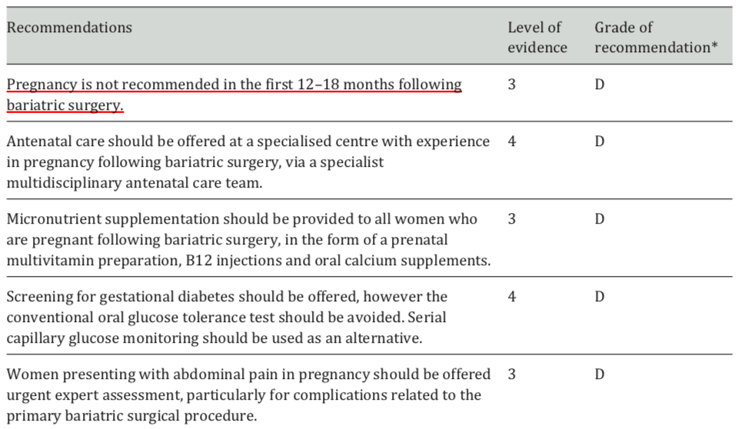
Busetto L et al, Practical Recommendations of the Obesity Management Task Force of the European Association for the Study of Obesity for the Post-Bariatric Surgery Medical Management, Obes Facts, 10:597-632, 2017

Slide 21
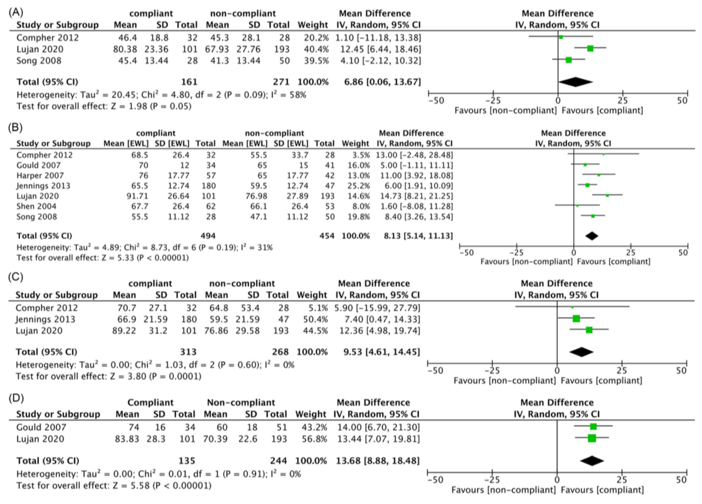
Jacobs A et al, Influence of mental and behavioral factors on weight loss after bariatric surgery: A systematic review and meta-analysis, Obes Rev, 7:e13729, 2024

Slide 22
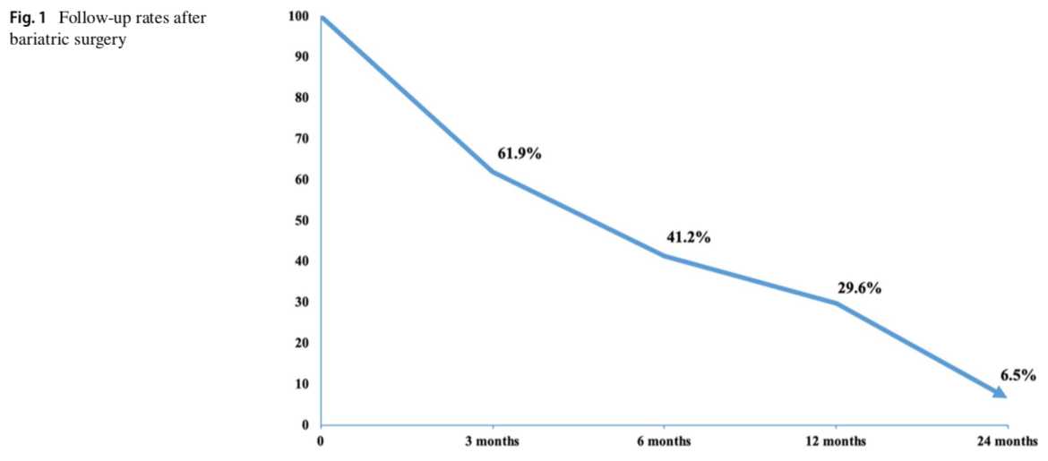
Schlottmann F et al, Postoperative Follow-up Compliance: The Achilles' Heel of Bariatric Surgery, Obes Surg, 33:2945-2948, 2023

Slide 23
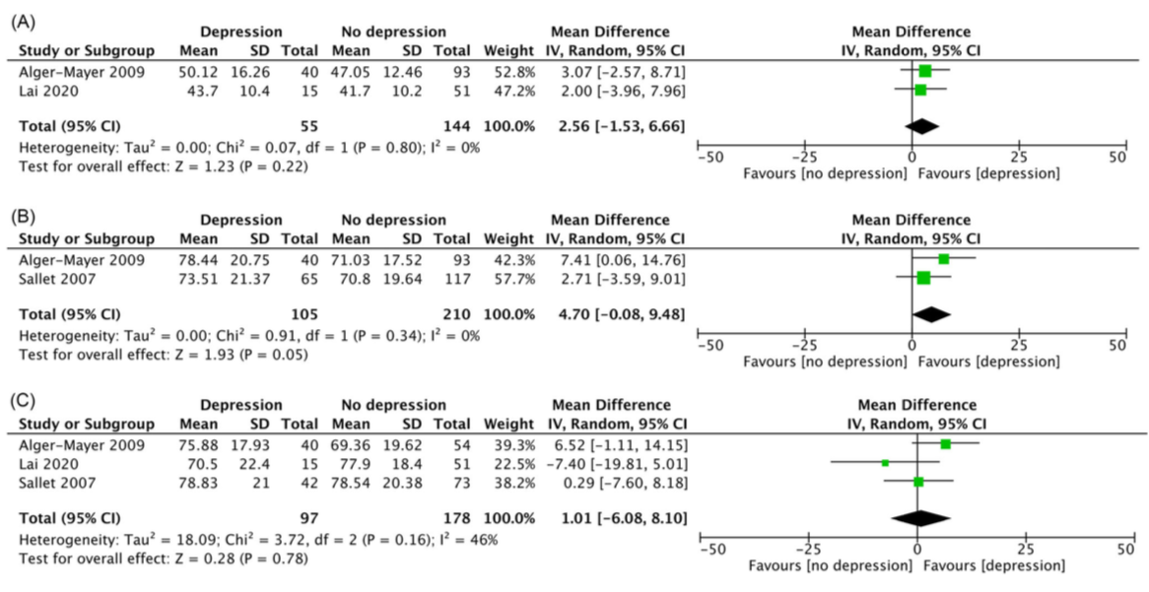
Jacobs A et al, Influence of mental and behavioral factors on weight loss after bariatric surgery: A systematic review and meta-analysis, Obes Rev, 7:e13729, 2024

Slide 24
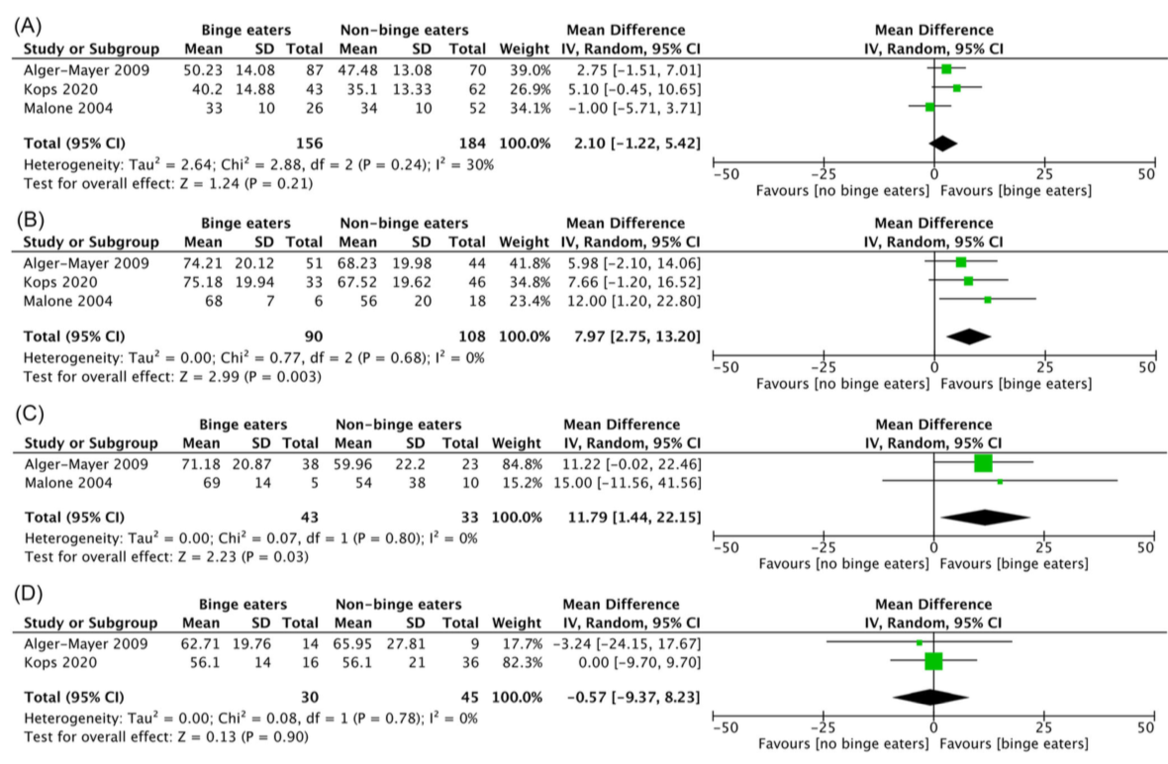
Jacobs A et al, Influence of mental and behavioral factors on weight loss after bariatric surgery: A systematic review and meta-analysis, Obes Rev, 7:e13729, 2024

Slide 25
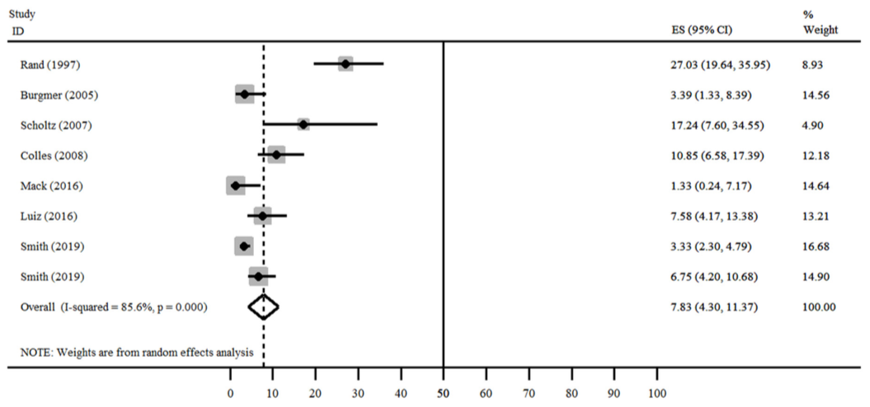
Taba JV et al, The Development of Feeding and Eating Disorders after Bariatric Surgery: A Systematic Review and Meta-Analysis, Nutrients, 13:2396, 2021

Slide 26
Jacobs A et al, Influence of mental and behavioral factors on weight loss after bariatric surgery: A systematic review and meta-analysis, Obes Rev, 7:e13729, 2024

Slide 27
Studies identified in our review found statistically significant reductions in anxiety and depressive symptoms following the first 24 months after surgery. The largest reductions were seen in depressive symptoms within the first two years following surgery
All studies saw depression scores increase after the 2-3 year mark post-operatively.
We were unable to find the cause for this increase in depressive symptom severity
Gill H et al, The long‐term effect of bariatric surgery on depression and anxiety, J Affect Disord, 246:886‐894, 2019

Slide 28
GS Jakobsen et al, Association of Bariatric Surgery vs Medical Obesity Treatment With Long-term Medical Complications and Obesity-Related Comorbidities, 319:291-301, 2018

Slide 29
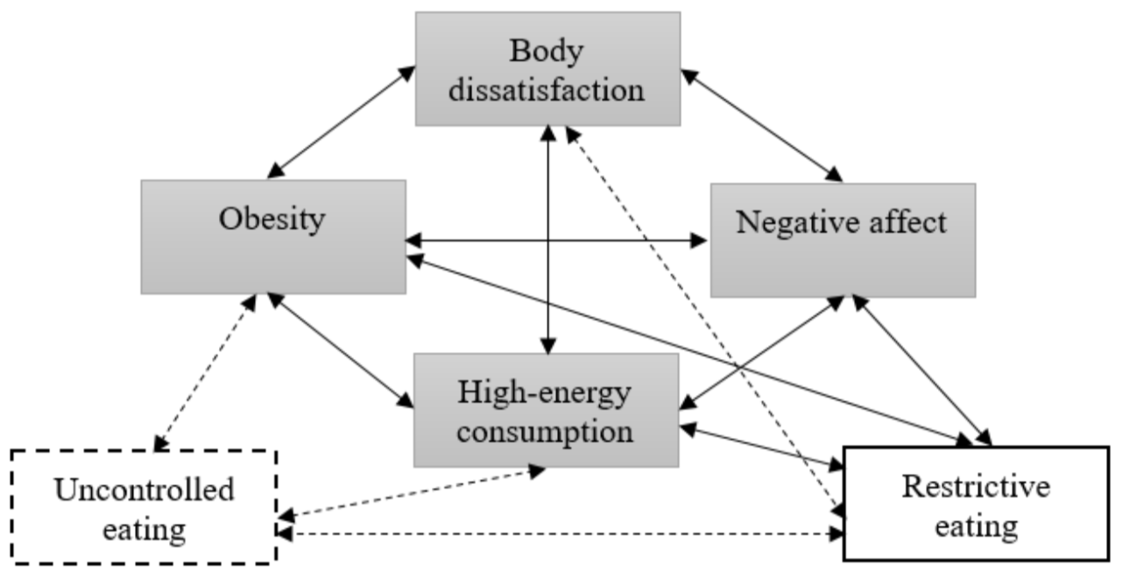
Czepczor-Bernat K et al, The Homeostatic Theory of Obesity: An Empirical Verification of the Circle of Discontent with an Assessment of Its Relationship to Restrained and Uncontrolled Eating among Children and Adolescents, Int J Environ Res Public Health, 17:6028, 2020

Slide 30
The current evidence is strongest for the impact of psychosocial interventions on eating behaviours (eg, binge eating and emotional eating) and psychological functioning (quality of life, depression and anxiety)
The evidence for the impact of psychosocial interventions on weight loss, dietary behaviours (eg, dietary intake), and lifestyle behaviours (eg, physical activity) is relatively weak and mixed
Additional support from dieticians and physical therapists may be warranted for targeted dietary and physical activity interventions
While there is some evidence to suggest that post‐operative behavioural modification interventions in particular may improve weight loss, at present, preoperative psychosocial interventions have not been found to improve post‐operative weight loss outcomes, nor have post‐operative psychosocial interventions in patients already experiencing premature weight regain
The optimal time to initiate psychosocial interventions is early in the post‐operative period, before significant problematic eating behaviours and weight regain occur
David LA et al, Preoperative and post‐operative psychosocial interventions for bariatric surgery patients: A systematic review, Obes Rev, 21:e12926, 2020

Slide 31
Grazie per
l’attenzione

